Slide 1

Phishing Website Detection in Machine Learning
Credit: Thesslstore.com
Presented By: Name

Slide 2
Table of Contents
Introduction
Problem Statement
Methodology
Data Wrangling
Data Analysis
Data Pre-processing
Conclusion
References

Slide 3
Introduction
Online scams are increasing with the rapid increase in the advancement of technology in the internet world. In cybercrimes, phishing websites are a common concern where criminals or hackers use phishing websites to steal the sensitive information of people.
These websites are similar to the authentic ones because they use the same visual appearance, icons, logos, etc. to trick people to fall prey. Phishers commonly target financial or payment institutions to steal information like banks or credit card details.
Anti-Phishing Working Group reports that at least 316,747 phishing attacks happened in December 2021– highest no. ever recorded (Globalnewswire, 2022).
Therefore, to protect the user’s sensitive information, we need advance tools to counter the phisher’s plotted traps and make internet a safer place for generations to come.

Slide 4
Problem Statement
Develop a supervised machine learning model that detects phishing website based on available website’s data.

Slide 5

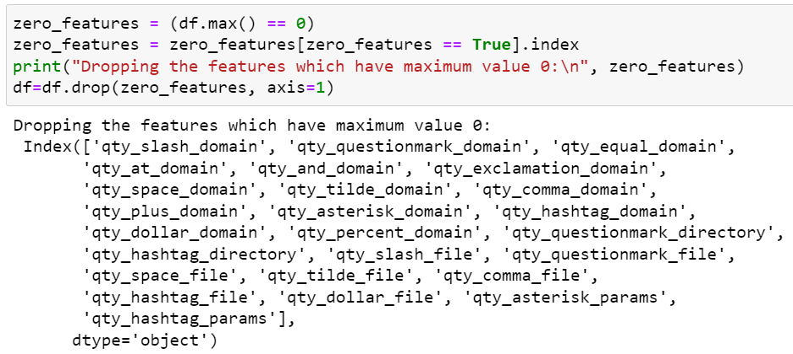

Data Wrangling
I took sample of 10,000 rows from the dataset through pandas sample function.
I removed all those features that have features maximum value equal to zero. This is because these features have no importance and therefore it is important that we neglect those in modelling of our project.
I’m dropping asn_ip feature because it is a unique feature and I don’t need it in my project.

Slide 6
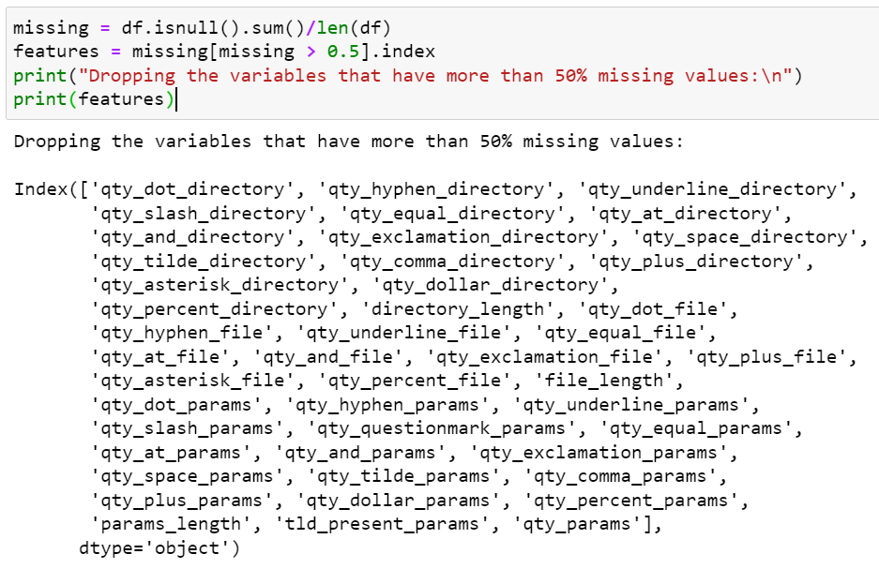

Data Wrangling…
I removed all those features that have more than 50% of missing values. This is because it poses problem in modelling and the accuracy of the model is affected.
I dropped null values present in the dataset using dropna() function based on rows as axis equal to 0.

Slide 7
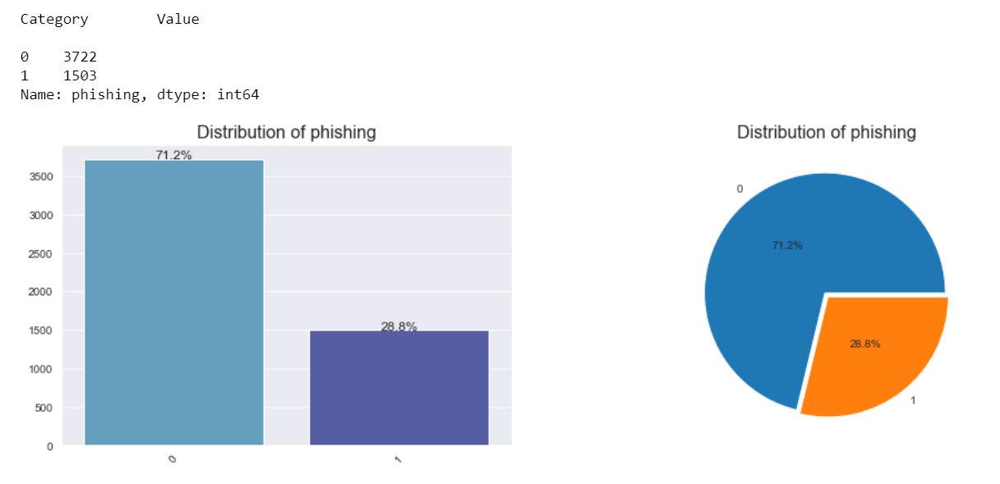
Methodology: Data Analysis
There are 3722 rows of 0 class label and 1 class label for 1503 for 1. In other words, there are 71% distribution of 0 class label and only 28% of 1 class label. This clearly means that the dataset is highly imbalanced, therefore, I will balance the dataset in data pre-processing phase.

Slide 8
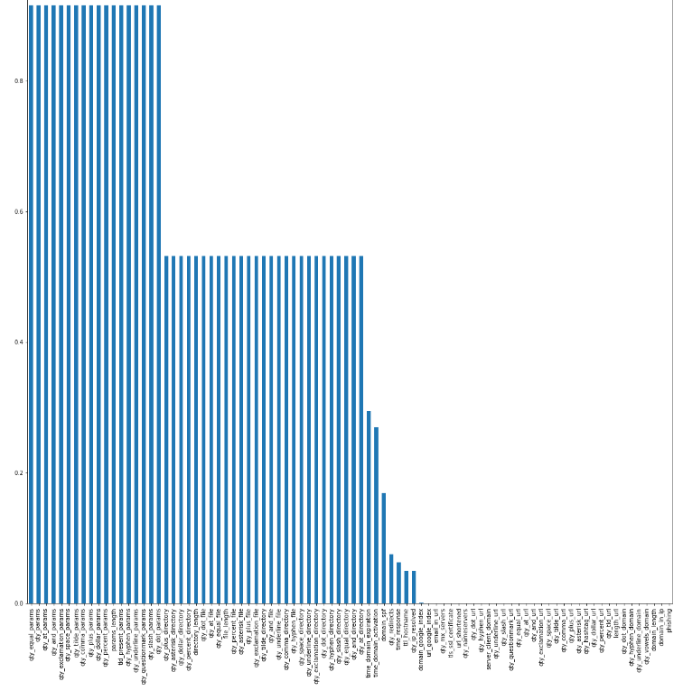
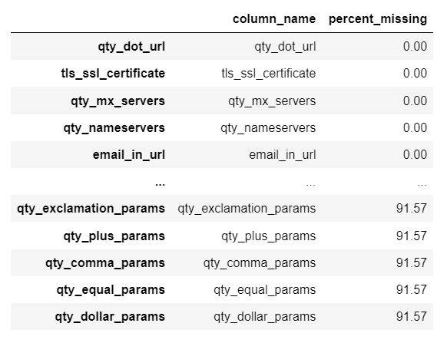
Data Analysis…
There are some features that have missing values present in the dataset. For example, feature qty_exclamation_params, qty_plus_params, qty_comma_params have 91.57% of missing values in the dataset.

Slide 9
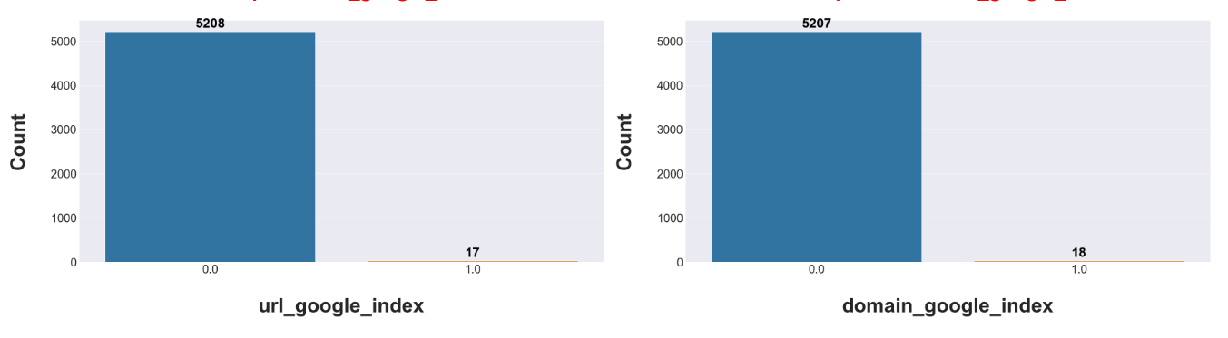
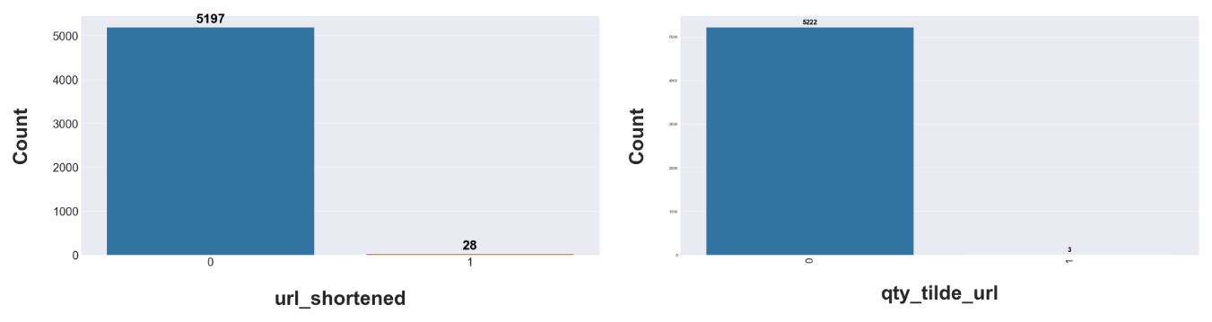
Data Analysis…
Distribution of url_google_index and domain_google_index can be seen where url_google_index has 5206 rows 0 class label and 17 for other class label. Similarly, domain_google_index has 5207 rows of 0 class label and 18 rows of 1 class label.
The distribution of url_shortened & qty_tilde_url can be seen where url_shortened has 5197 rows of 0 class label and 28 rows of 1 class label, similarly, qty_tilde_url has 5222 rows of 0 class label and 3 rows of 1 class label.

Slide 10
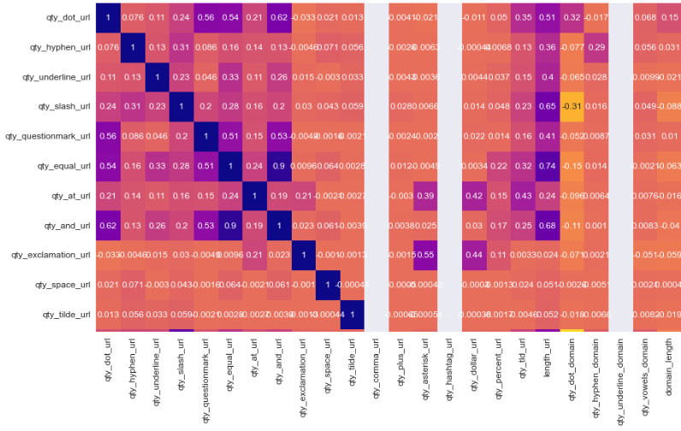
Data Analysis…
Correlation heatmap graph can be seen that shows the correlation of features of the dataset. It can be seen that qty_dot_url has a correlation of 0.62 with qty_and_url, qty_underline_url has a correlation value of 0.33 with qty_equal_url.

Slide 11

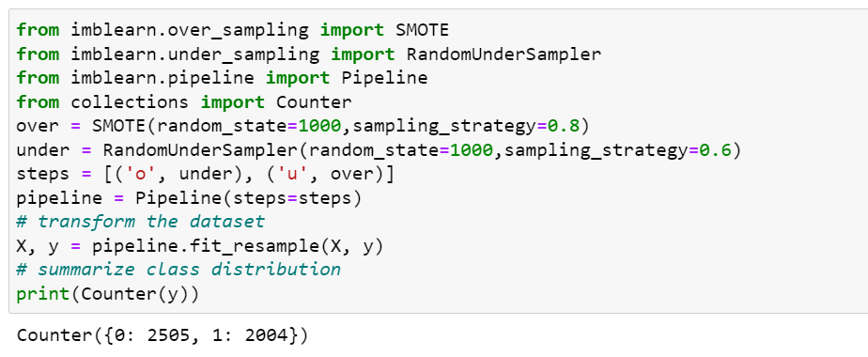
Data Pre-processing…
I dropped defined the input and output variables where X variable is defined all features except ‘phishing’ feature and ‘y’ variable had defined by ‘phishing’ feature.
Oversampling and under sampling using SMOTE library can be seen where I used Pipeline with sampling_strategy with value 0.8 for over sampling and 0.6 with under sampling. It can be seen that after performing oversampling and under sampling with 0 class label equal to 2505 rows and with 1 class label equal to 2004 rows.

Slide 12
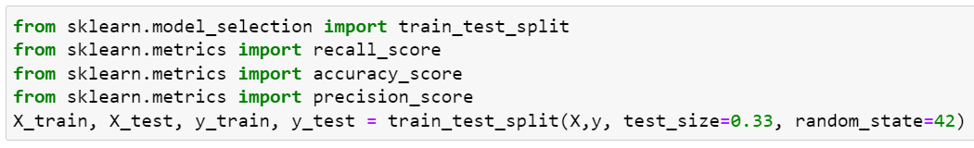
Data Pre-processing…
I split the dataset into testing and training using Sklearn library with test_size equal to 0.33, and random_state equal to 42.

Slide 13
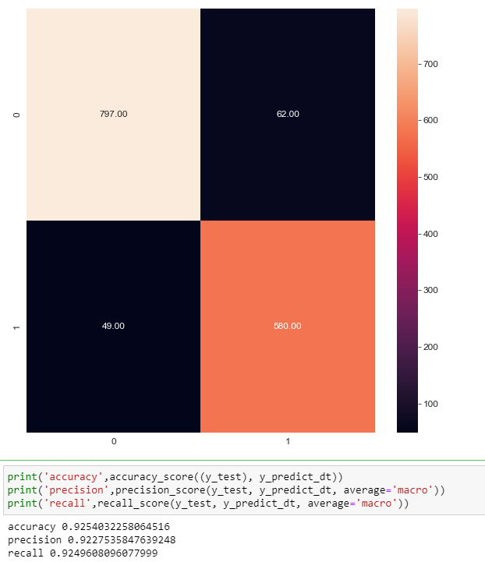
Decision Tree
After hyper-parameter tuning Decision Tree was implemented with parameters: ccp_alpha=0.001, criterion=’entropy’, max_depth=8, max_features=’auto’, and random_state=1024 provided by GridSearchCV() function of sklearn library.
The confusion matrix displays the performance summary of the Decision Tree Model. Decision tree had a accuracy of 92%, precision of 92%, and recall was also of 92%. It predicted 0 class label as 0 797 times rightly, and 62 times wrong. Similarly, it predicted 1 class label as 1 580 times rightly, and 49 times wrong.

Slide 14
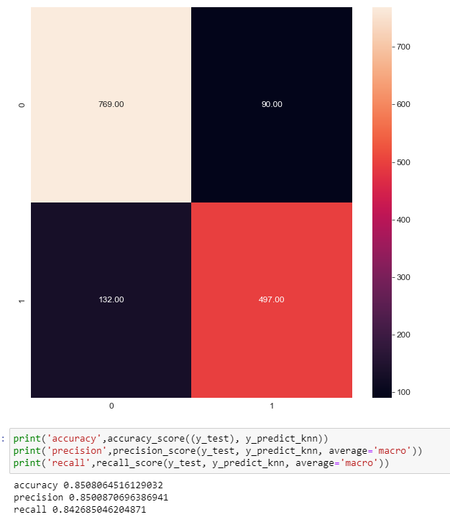
K-nearest Neighbor
I implemented K-nearest neighbour classifier for hyper-parameter tuning using GridSearchCV(). It provided with optimal hyper-parameters: algorithm='ball_tree', metric='manhattan', n_neighbors=10. Then, I implemented K-nearest neighbours with hyper-parameters.
The confusion matrix graph of K-nearest neighbour can be seen that displays the summary of the results. It had an accuracy of 85%, precision of 85%, and recall of 84%. KNN predicted 769 0 class labels as 0 rightly, while 90 were predicted wrong. Similarly, it predicted 497 1 class label as 1 rightly, while 132 were predicted wrong.

Slide 15
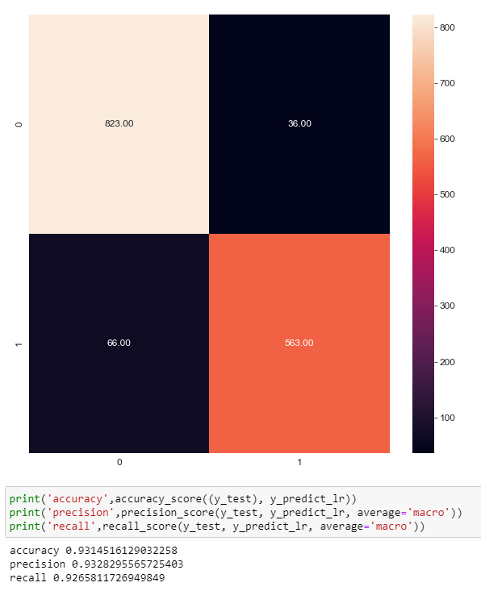
Logistic Regression
I implemented Logistic Regression classifier for hyper-parameter tuning using GridSearchCV(). It provided with optimal hyper-parameters: C=1.0, and penalty=12. Then, I implemented Logistic Regression.
The confusion matrix graph of Logistic Regression can be seen that displays the summary of the results. It had an accuracy of 93.1%, precision of 93.2%, and recall of 92.6%. Logistic Regression predicted 823 0 class labels as 0 rightly, while 36 were predicted wrong. Similarly, it predicted 563 1 class label as 1 rightly, while 66 were predicted wrong.

Slide 16
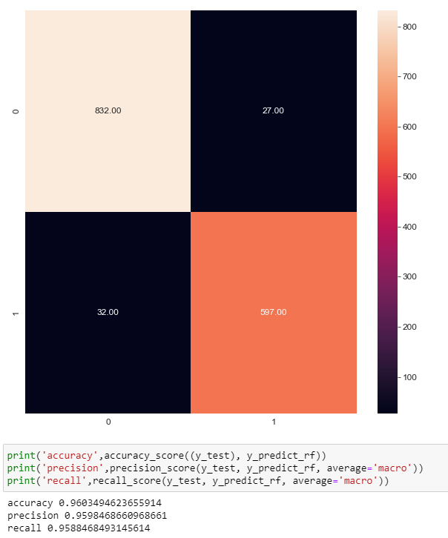
Random Forest
I implemented Random Forest classifier for hyper-parameter tuning using GridSearchCV(). It provided with optimal hyper-parameters: max_depth=8, and n_estimators=200.
The confusion matrix graph of Random Forest can be seen that displays the summary of the results. It had an accuracy of 96.0%, precision of 95.9%, and recall of 95.8%. Random Forest predicted 832 0 class labels as 0 rightly, while 27 were predicted wrong. Similarly, it predicted 597 1 class label as 1 rightly, while 32 were predicted wrong.

Slide 17
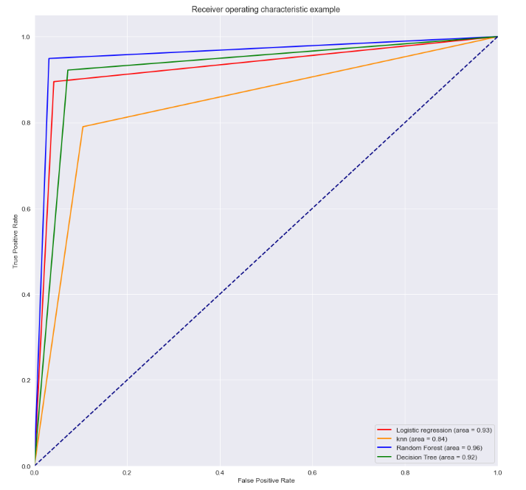
Evaluation & Results
After carefully, analysing the results of the models using performance metrics accuracy, precision, recall, confusion matrix, and Roc curve.
I came to a conclusion that Random Forest outperformed all other models with an accuracy of 96%, followed by Logistic Regression at 93%, Decision Tree at 92%, and Logistic Regression came at last with 84%.
The ROC curve of all models can be seen that represents the performance of all models.

Slide 18
Evaluation & Results
Table 1 shows the performance metrics of model: Accuracy, Precision and Recall for Decision Tree, K-nearest Neighbour, Logistic Regression, and Random Forest.
Sr. no. | ML Models | Accuracy | Precision | Recall
1 | Decision Tree Classifier | 92.5% | 92.2% | 92.4%
2 | K-Nearest Neighbor | 85.0% | 85.0% | 84.2%
3 | Logistic Regression | 93.1% | 93.2% | 92.6%
4 | Random Forest | 96.0% | 95.9% | 95.8%

Slide 19
Conclusion
In this project, I studied a dataset of phishing websites which was taken from Kaggle. The dataset contained a huge number of missing values, and some null values, therefore, I performed data wrangling to clean the dataset to perform the data analysis on the dataset.
I used various libraries such as Seaborn, Plotly, Matplotlib to perform multivariate and univariate analysis. Then, I performed pre-processing of the dataset by defining input and output variable, oversampling and undersampling using Smote, and split the dataset into testing and training for modelling.
Finally, I used hyper-parameter tuning using GridSearchCV() function to determine the optimal hyper-parameters to determine the best features for the models.
I build Decision Tree, Logistic Regression, K-nearest neighbor, and Random Forest to detect the phishing websites. I used performance metrics accuracy, precision, recall, and confusion metrics to determine the best model that performs best.
I found that Random Forest outperformed all others with an accuracy of 96%. So, I selected Random Forest as the best model for this study.

Slide 20
References
Altair, 2022. What is Data Wrangling. Altair. Available at: https://www.altair.com/what-is-data-wrangling
Afroz S., GreenStatd, R., 2021. Phishzoo: detecting phishing websites by looking at them. Available at: https://ieeexplore.ieee.org/document/6061361/
Javatpoint Team. 2022. Random Forest Algorithm, javatpoint, Available at: https://www.javatpoint.com/machine-learning-random-forest-algorithm
Javatpoint Team. 2022. Logistic Regression in Machine Learning. Javatpoint, Available at: https://www.javatpoint.com/logistic-regression-in-machine-learning
Javatpoint Team. 2022. K-Nearest Neighbor (KNN) Algorithm for Machine Learning. Javatpoint, Available at: https://www.javatpoint.com/k-nearest-neighbor-algorithm-for-machine-learning
Javatpoint Team. 2022. Decision Tree Classification Algorithm. Javatpoint, Available at: https://www.javatpoint.com/machine-learning-decision-tree-classification-algorithm

Slide 21
References…
Kumar, A., 2022. Correlation Concepts, Matrix & Heatmap using Seaborn. Vitalflux, Available at: https://vitalflux.com/correlationheatmap-with-seaborn-pandas/
Gad, A.F, 2022. Evaluating Deep Learning Models: The Confusion Matrix, Accuracy, Precision, and Recall. Paperspace Blog. Available at: https://blog.paperspace.com/deep-learning-metrics-precision-recall-accuracy/
Google. 2022. “Classification: ROC Curve and AUC”, developers.google.com, Available at: https://developers.google.com/machine-learning/crash-course/classification/roc-and-auc#:~:text=An%20ROC%20curve%20(receiver%20operating,False%20Positive%20Rate
Zubair, M.D, 2021. Find the Patterns of a Dataset by Visualizing Frequency Distribution. Towards Data Science. Available at: https://towardsdatascience.com/find-the-patterns-of-a-dataset-by-visualizing-frequency-distribution-c5718ab1f2c2
APWG, 2022. Phishing Hits All-Time High in December 2021; Attacks Triple Since Early 2020. Globalnewswire. Available at: https://www.globenewswire.com/en/news-release/2022/02/25/2392052/0/en/APWG-Q4-Report-Phishing-Hits-All-Time-High-in-December-2021-Attacks-Triple-Since-Early-2020.html#:~:text=25%2C%202022%20(GLOBE%20NEWSWIRE),has%20tripled%20from%20early%202020.

